Slide 1
Experiences from SEEA Projects implemented in the Russian Federation at the national, local and municipal level Joint OECD/UNECE Seminar on the Implementation of SEEA 21‐22 February 2018, Geneva
Georgy Fomenko
Professor, Doctor of Science in Geography, Chair of the Board
Marina Fomenko
PhD in Geography, Deputy Executive Director

Slide 2
The basis for SEEA development in Russia
1. Federal Law of the RSFSR No. 2060-1 of 19.12.1991 “On Environmental Protection”, Article 16. “Accounting and socio-economic assessment of natural resources: state environmental agencies, in cooperation with state statistics agencies, natural resource users conduct quantitative and qualitative accounting of natural resources and recyclable materials, and determine their socio-economic assessment”*
2. The Order of the Deputy Chairman of the Council of Ministers - the Government of the Russian Federation No. 58-rz of 07.05.1993 “On the Improvement of Quantitative and Qualitative Accounting of Natural Resources”
3. Order of the Ministry of Environmental Protection and Natural Resources of the Russian Federation No. 103 of 27.05.1993 “On Conducting of Experiment on Improving Accounting and the Social-Economic Assessment of the Natural Resource Potential”
4. Order of the Ministry of Environmental Protection and Natural Resources of the Russian Federation No. 326 of 17.08.1995 “On approval of the Provisional Regulations on the Development of Complex Territorial Cadastres of Natural Resources and Objects”
*At the present moment the Federal Law No. 7-FZ of 10.01.2002 is in force (as amended on 31.12.2017) “On Environmental Protection”, which provides for the economic evaluation of natural and human-natural objects (Article 5) and the creation of a unified system of state environmental monitoring (Articles 63, 63.1.63.2)

Slide 3
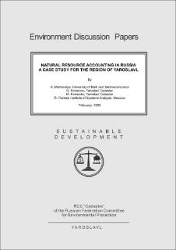
Federal Experiment on Improving Accounting and Socio-economic Assessment of Natural Resources Potential (Order of the Council of Ministers of the Government of the Russian Federation of May 7, 1993 No. 58-rz)
1. The experiment involved 32 federal subjects of the Russian Federation. It resulted in the adopted resolutions of the Heads of the federal subjects of the Russian Federation on the organization of accounting and socio-economic assessment of the natural resource potential.
2. 1993 - Cadaster Institute was established as a subordinate organization of the Ministry of Natural Resources of Russia for scientific and methodological support of accounting and socio-economic assessment of the natural resource potential.
3. 1993, 1995 - all-Russian seminars on the improvement of accounting and socio-economic assessment of the natural resource potential were conducted in Cadaster Institute.
4. 1996-2000 - Cadaster Institute carried out the first works on the implementation of the SNA / SEEA. Under the guidance of Professor Anil Markandya (World Bank), and obtained the first results on the monetary assessment of the natural capital of the federal subject of the Russian Federation and the municipal district (Yaroslavl Region).

Slide 4
Most significant projects on natural capital accounting and assessment using SEEA (experience of Cadaster Institute)
The targets of the natural resource management | Location / Customer / Year
Federal level
1. Methodological support of SEEA | Methodologies for calculating (1) indicators of the economic value of biological resources; (2) the volume of environmental expenditures by types and directions of costs / Rosstat / 2014, 2007-2009
2. Methodological support of SEEA development | Methodology for the development of SEEA accounts for various types of natural assets / Russian Ministry of Environment/ 2014-2015.
3. Information support of SNA connecting with natural resources | Obtaining the first assessment indicators for natural resources of the Russian Federation and Russian federal subjects for the development of SNA / Russian Ministry of Environment, with the participation of Rosstat / 2007-2009.
4. Increasing the management efficiency of the system of specially protected areas of federal significance | Obtaining and monitoring of indicators of economic value of natural resources and ecosystem services provided by PAs (97 reserves and 40 national parks) / Russian Ministry of Environment/ 2010, 2015
5. Development of management plans for protected areas of federal significance | Reserve "Stolby" / State natural reserve "Stolby" / 2012 National Park "Pleshcheyevo Lake" / Rosprirodnadzor / 2005 Kostomukshsky Reserve / Rosprirodnadzor / 2005
Federal subject level
1. Increasing the efficiency of the use of natural resources and environmental protection | Proposals on the territory development programs and plans for the Yaroslavl, Kaluga, Leningrad, Ryazan, Tomsk regions, the Republic of North Ossetia-Alania and others / administrations of the subjects of the Russian Federation, Russian Ministry of Environment/ 1998-2008.
2. Planning and development of specially protected areas of regional importance | Obtaining indicators of economic evaluation of natural resources and ecosystem services and their inclusion in the management of regional PAs by subjects of the Russian Federation: the Yaroslavl, Kaliningrad, Kaluga, Kostroma, Ryazan, Tomsk, Kamchatka, Krasnodar Regions, Republic of North Ossetia-Alania, Karachay-Cherkessia Republic and others / administrations of federal subjects, UNDP, GEF, Russian Ministry of Environment / 1998-2017
3. Development of measures to increase the efficiency of the use of natural capital | Ecosystem Services Assessment in the Yaroslavl Region / Administration of the Yaroslavl Region / 2017
Municipal level
1. Preventing a budget crisis of the territory | Forecasting the depletion of the mineral resources in the municipal district for promotion of compensatory measures / the administration of the Saratov region / 1999.
2. Preservation of parks and green spaces as the basis for maintaining biodiversity in cities and towns | Assessment of the socio-economic value of the urban park for the development of measures for its conservation (including adjusting the payment for land) / Kostroma administration / 1999.
3. Increasing the effectiveness of planning of socio-economic development at the municipal level | Economic evaluation of natural resources as an information basis for the program of environmental management and transition to sustainable development for: (1) Danilov district, (2) Pervomaisky district (Yaroslavl region), (3) Iraf district (Republic of North Ossetia-Alania), (4) Mikhailovsky district (Ryazan region) / Rosprirodnadzor, administrations of federal subjects of the Russian Federation, municipalities / 1996-1997, 2002, 2005.
4. Development of a strategy for social and economic development. Implementation of the Strategic Environmental Assessment (SEA) | Assessment of the ecosystem services of the coal-mining area to improve the information support of planning the socio-economic development of the territory / UNDP / 2016-2017.
Local level
1. Prevention and resolving of conflict s in environmental management | Economic evaluation of natural resources and ecosystem services provided to different users aimed at development of conciliation measures / Administration of the Tomsk region / 1999-2000.
2. Prevention of ethnic tension in the planning and implementation of wildlife protection measures | The economic assessment of natural resources and ecosystem services aimed at justifying the environmental restrictions when creating PAs in the rural municipality Arkhyz / CEPF for the Caucasus (Caucasus Hotspot) / 2005.
3. Increasing the efficiency of municipal water supply | Economic assessment of water in the household sector to promote reasonable decisions to improve rural water supply in the Danilovsky District of the Yaroslavl Region / GEF, Yaroslavl Region Administration / 1999.

Slide 5
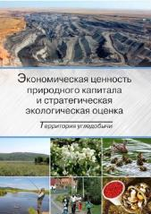
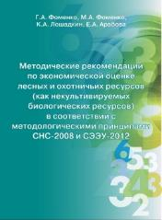
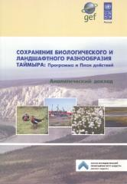
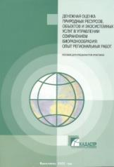
Library
http://ntc-rik.ru/en/knowledge-center/library/

Slide 6
Conclusion 1- Systematic implementation, taking advantages of sectoral and territorial approaches
Sectoral approach – provides system information for strategic management, primarily at the national level; increases the effectiveness of management of various components of natural capital (subsoil resources, water, forest resources, etc.)
Territorial approach – supports the adoption of decisions on the territory development, the prevention of socially dangerous depletion of natural resources, the assessment of the external investment effectiveness aimed at sustainable territory development

Slide 7
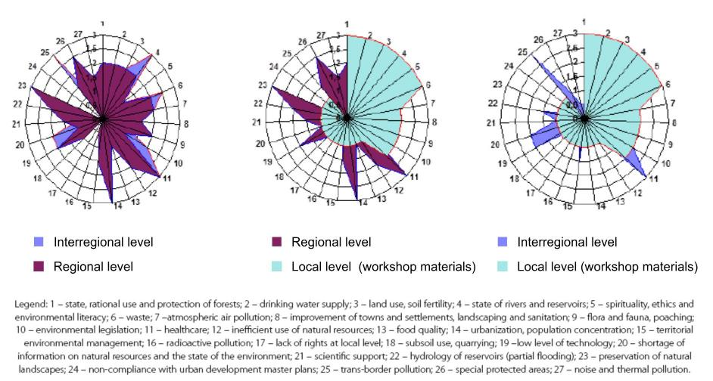
Conclusion 2 – Orientation towards Sustainable Development Goals
Priorities correlation of territories of different levels
(as exemplified by Yaroslavl Region)
Source: Fomenko, G. (2017) Environmental management: A Socio-Cultural Methodology. Costa Rica: Institute for Sustainable Innovation.

Slide 8
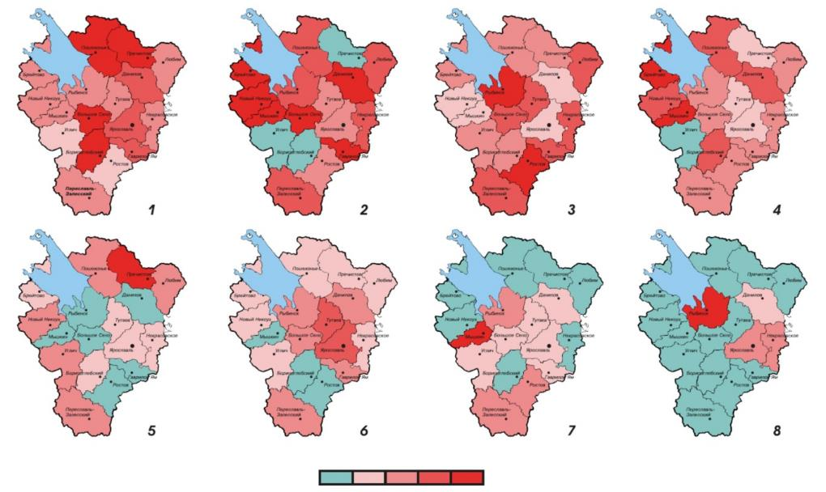
Conclusion 2 – Orientation towards Sustainable Development Goals
Main priorities for sustainable development in Yaroslavl Region
(as perceived by stakeholders)
Legend: 1. condition, rational use and protection of forests; 2. drinking water supply; 3. land use, soil fertility; 4. state of rivers and reservoirs; 5. spirituality, ethics and environmental literacy of population; 6. waste; 7. atmospheric air pollution; 8. landscaping of towns and settlements, sanitation
Source: Fomenko, G. & Fomenko, M. (2016) Economic Transition and Environmental Conservation: Sociocultural Aspects. Yaroslavl: Cadaster Institute.

Slide 9
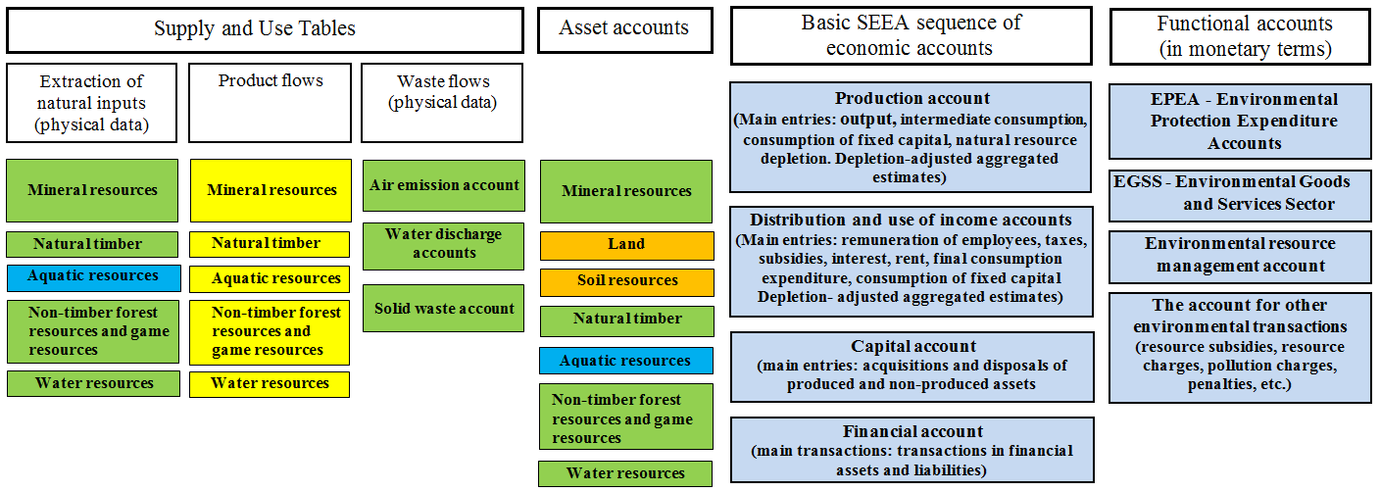
Conclusion 3 – Departments interaction
Functional spheres of federal executive bodies in accumulating input information for environmental-economic accounting
Source: Fomenko, G., Fomenko, M., Loshadkin K., Mikhailova A., & Arabova E. (2017) Environmental-Economic Accounting
in Resource Use: Theory and Practice. Yaroslavl: Cadaster Institute.

Slide 10
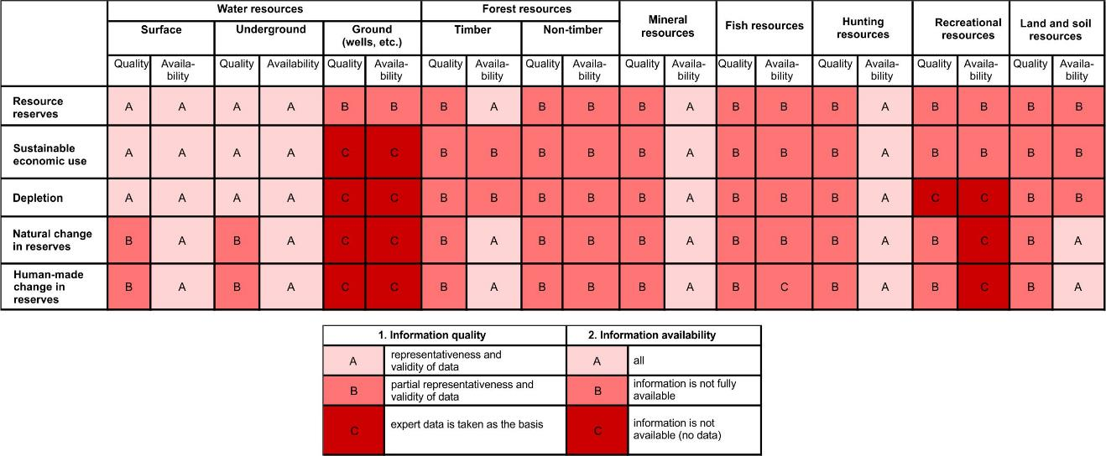
Conclusion 4 – Attention to original data and its completeness
Quality and availability of data for SEEA development
Source: Cadaster Institute data, 2017

Slide 11
Conclusion 4 – Attention to original data and its completeness
Comparison of Natural Resource Evaluation Methods (on the example of Tomsk Region (West Siberia), millions of rubles)
Indicator | Mineral resources |  | Water resources |  | Forest resources |  |  |  | Aquatic resources |  | Hunting resources
 |  |  |  |  | Timber |  | Non-timber
Valuation in the Beginning of the Year | 1538697 | 770867,5 | 5264,7 | 5217,4 | 4517,4 | 1135,4 | 28429,4 | 6 | 736,2 | 6,8 | 87,3 | 70,4
Economic Use of Resources | 47944,1 | 24241,1 | 166,6 | 164,1 | 143 | 35,7 | 836,7 | 0,2 | 22,7 | 0,2 | 2,2 | 2,2
- Valuation based on resulting profits
- Valuation based on the amount of resource taxes
Sources: 1. Report on research work "Assessment of Natural Capital of Tomsk Region“. Cadaster Institute. 2008.
2. Report on research work "Development of a Methodology for Including Value of Natural Resources in the System of National Accounts (SNA)", Cadaster Institute, 2007-2009.

Slide 12
Conclusion 4 – Attention to original data and its completeness
“White” and “grey” matrices for SEEA, Pervomaisky District, Yaroslavl Region (Central Russia)
“White” matrix for physical accounting of natural resources, 1999
 | Water resources thous. |  | Timber resources, thous. m³ |  |  | Mineral resources, thous, m³ |  | Game resources, individuals |  |  |  | Land resources, thous. h
 | Surface water | Ground-water | Total | Conifers | Broad-leaved trees | Total | Sand and gravel including | Total | Bear | Moose (elk) | Boar | Farm land | Settlements
Opening stock | 5,681.5 | 1,620 | 184.9 | 30.5 | 154.4 | 6,779.7 | 2,372.8 | 1,450 | 70 | 1,330 | 50 | 131.06 | 5.855
Economic use
- sustainable use | -25.5 | -518 | -104.2 | -16.4 | -87.8 |  |  | -109 | -11 | - 82 | -16
-depletion |  | -5 |  |  |  | -50 | -49 | -1 |  |  | -1
Other accumulation | 25.5 | 518 | 158.9 | 30.2 | 128.7 |  |  | 109 | 11 | 82 | 16 | 3.48 | 0.007
Other changes |  |  |  |  |  |  |  | -359 | 0 | 409 | 50
Closing stock (December 31, 2004) | 5,681.5 | 1,615 | 239.6 | 44.3 | 195.3 | 6,729.7 | 2,323.8 | 1,090 | 70 | 920 | 100 | 134.54 | 5,862
“Grey” matrix for physical accounting of natural resources, 1999
 | Water resources, thous. m³ |  |  | Timber resources |  |  |  |  |  |  | Mineral resources, thous. m³ |  | Game resources, individuals |  |  |  | Land resources, thous. h
 |  |  |  | Timber, thous. m³ |  |  | Non-timber, t
 | Surface water | Ground water (water supply utilities) | Ground water (wells) | Total | Coni-fers | Broad-leaved trees | Total | Mushrooms | Berries | Medici-nal plants | Total | Inclu- ding sand and gravel | Total | Bear | Moose (elk) | Boar | Farm land | Settle-ments
Opening stock | 5,681.5 | 1,620 |  | 184.9 | 30.5 | 154.4 | 2,952.8 | 2,318 | 191.8 | 443 | 6,779.7 | 2,372.8 | 1,450 | 70 | 1,330 | 50 | 131.06 | 5.855
Economic use
- sustainable use | -28.9 | -518 | -201.6 | -116.7 | -16.4 | -87.8 | -609.1 | -341.9 | -191.8 | -75.4 |  |  | -109 | -11 | - 82 | -16
-depletion |  | -5 |  |  |  |  |  |  |  |  | -50 | -49 | -1 |  | -1
Other accumulation | 28.9 | 518 | 201.6 | 171.4 | 30.2 | 128.7 | 609.1 | 141.9 | 191.8 | 75.4 |  |  | 109 | 11 | 82 | 16 | 3.48 | 0.007
Other changes |  |  |  |  |  |  |  |  |  |  |  |  | -359 | 0 | -409 | 50
Closing stock (December 31, 2004) | 5,681.5 | 1,615 |  | 239.6 | 44.3 | 195.3 | 2,952.8 | 2,318 | 191.8 | 443 | 6,729.7 | 2,323.8 | 1,090 | 70 | 920 | 100 | 134.54 | 5,862
Source: Fomenko, G., Fomenko, M., Loshadkin K., Mikhailova A., & Arabova E. (2017) Environmental-Economic Accounting in Resource Use: Theory and Practice. Yaroslavl: Cadaster Institute.

Slide 13
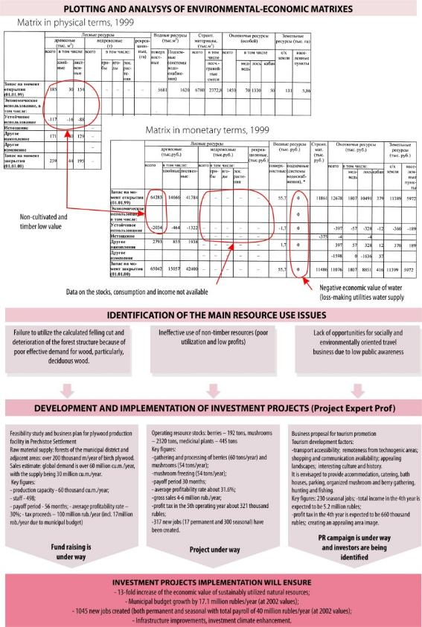
Conclusion 5 – Implementation of SEEA methodology for purposes of territory management
Investment planning based on integrated environmental and economic accounting in Pervomaisky district of Yaroslavl Region (Central Russia)
*Golden medal of IV Moscow International Salon of Innovations and Investments
Source: Fomenko, G. & Fomenko, M. (2016) Economic Transition and Environmental Conservation: Sociocultural Aspects. Yaroslavl: Cadaster Institute.

Slide 14
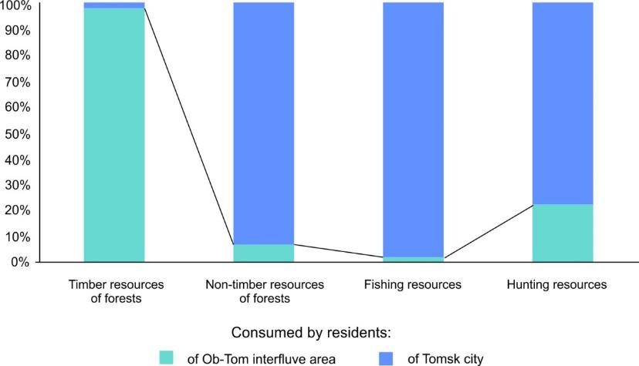
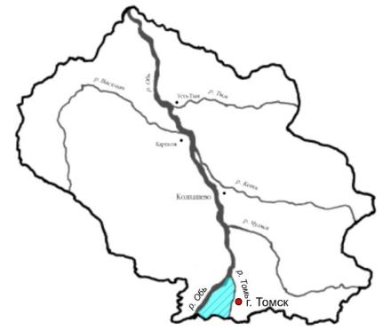
Conclusion 5 – Implementation of SEEA methodology for purposes of territory management
Eco-system service structure in the Ob-Tom interfluve area (West Siberia)
Source: Fomenko, G., Fomenko, M., Loshadkin K., Mikhailova A., & Arabova E. (2017) Environmental-Economic Accounting in Resource Use: Theory and Practice. Yaroslavl: Cadaster Institute.

Slide 15
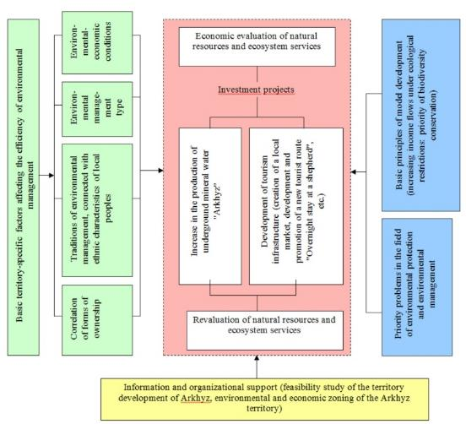
Conclusion 5 – Implementation of SEEA methodology for purposes of territory management
Economic value of natural resources and ecosystem services for substantiation of ecological restrictions when establishing PAs in rural municipality Arkhyz (Karachaevo-Cherkessia, Caucasus)
Distribution of income among main consumers
The model of economic activity ("sustainable use of natural resources")
thous.rub./year
thous.rub./year
year
thous.rub./
thous.rub./year
thous.rub./year
mineral water resources
forest resources
recreational resources
land and soil resources
General income flow
Business
Non resident visitors
Local residents
World community
Arkhyz budget
Karachay-Cherkessia Republic budget
mineral water resources
timber and non-timber forest resources
carbon sequestration
recreational resources
land and soil resources
Source: Fomenko, G., Fomenko, M. & Mikhailova, A. (2006). Arkhyz: On the Path to Sustainable Development. Yaroslavl, Cadaster Institute.

Slide 16
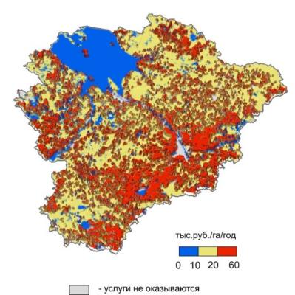
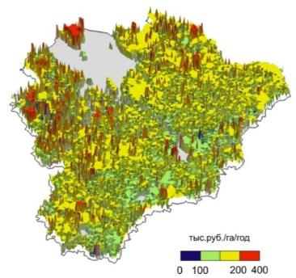
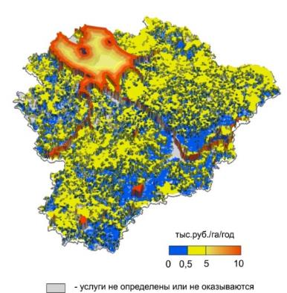
Conclusion 6 – Promoting SEEA through ecosystem services assessment and their mapping
The economic value of ecosystem services in the Yaroslavl region (Central Russia), thousand rubles/ha/year
Provisioning ecosystem services
Regulating ecosystem services
Cultural ecosystem services
Ecosystem services | Economic value source | Value, million rubles / year
Provisioning | Wood Non-timber forest resources Water resources Hunting resources Fish resources Agricultural products | 8071,11
Regulating | Regulation of climate and air composition Regulation of water resources Waste assimilation Wildlife conservation Soil formation Pollination | 487556,85
Cultural | Recreation Aesthetic and hedonic value | 53843,8
Source: Report on State of the Environment and Environment al Protection of the Yaroslavl Region in 2015-2016. (2017). Sc. ed. Fomenko, G. Department of Environmental Protection and Nature Management of the Yaroslavl Region. Yaroslavl,.

Slide 17
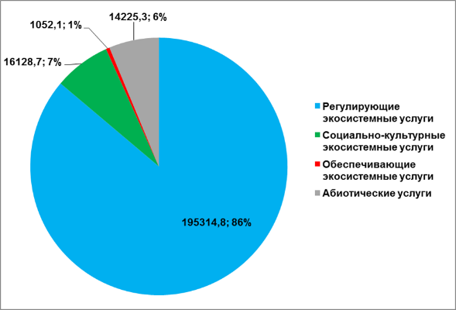
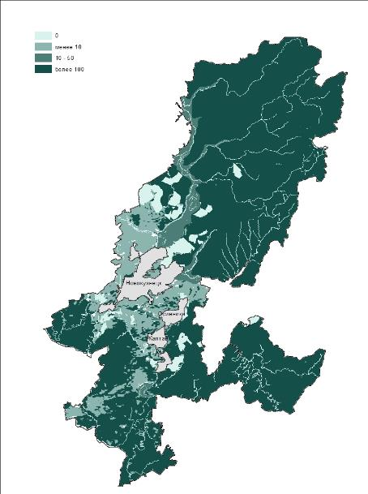
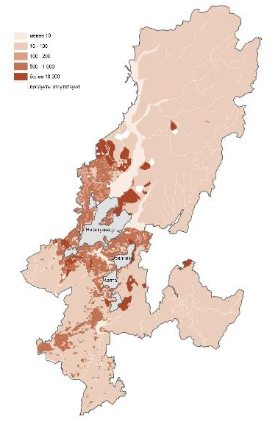
Conclusion 6 – Promoting SEEA through ecosystem services assessment and their mapping
The economic value of the ecosystem and abiotic services of the Novokuznetsk municipal district (Kemerovo Region, West Siberia)
Regulating ecosystem services, billion rubles/year
Provisioning ecosystem services and abiotic services, million rubles/year
coal extraction
Regulating ecosystem services
Socio-cultural ecosystem services
Provisioning ecosystem services
Abiotic services (coal extraction)
Source: Fomenko, G., Fomenko, M. & Loshadkin, K. (2018) Economic value of natural capital and strategic environmental assessment. Territory of coal mining / Sc. ed.. Fomenko, G. Yaroslavl. (in press)

Slide 18
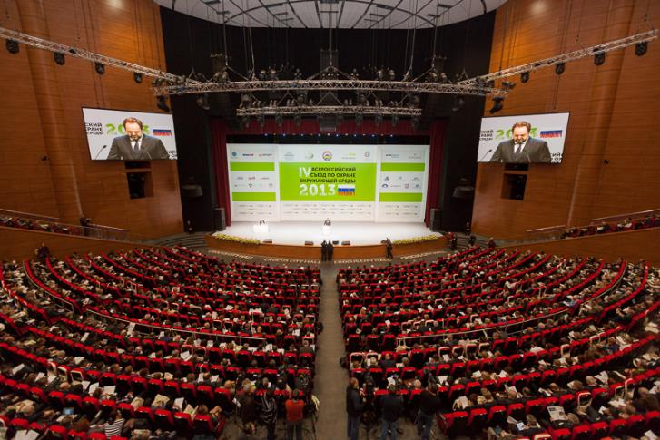
Future prospects of SEEA in Russia
Abstract of Resolution of IV All-Russian Congress on Environmental Protection: “When implementing the principles of the green economy, it is necessary to take into account the improvement of environmental statistics, drawing attention to improving the completeness and quality of accounting of environmental investments and other costs at micro- and macro levels, the development, amendments and adjustment of federal and departmental statistical data, as well as the implementation of international standards in the field of the System of National Accounts and the corresponding System of Environmental and Economic Accounting” (art. 5.2)
The assessment of ecosystem services is defined as the main target of government policy by decisions of the State Council of the Russian Federation on the issue "On the ecological development of the Russian Federation in the interests of future generations" (December 27, 2016).

Slide 19
Thank you for attention!
E-mail: info@cadastr.org; info@group-rc. org www.cadastr.org www.ntc-rik.org
150043 22 Rosa Luxemburg Street,
Yaroslavl, Russia
+7 (4852) 75-19-83
*
Фоменко Г.А., Фоменко М.А., Лошадкин К.А., Михайлова А.В., Арабова Е.А.
* Environmental-Economic Accounting in Resource Use: Theory and Practice
Georgy Fomenko, Marina Fomenko, Konstantin Loshadkin, Anastasia Mikhailova, Elena Arabova
19

